Slide 1

Fundamentals of Programming Using C - 15101104
Unit 6 : File and its Operation
Bhavika Vaghela
Assistant Professor
Parul Institute of Computer Application
Faculty of IT & Computer Science
Parul University

Slide 2

Topics going to cover in File
Opening a File
Reading a File
Closing a File Text modes I/O operations on files Binary modes
File functions
fprintf() fscanf()
getc() putc()
fgetc() fputc()
fseek() feof()
Command line arguments

Slide 3
Introduction of file
A file is a collection of related data that a computers treats as a single unit
Computers store files to secondary storage so that the contents of files remain intact when a computer shuts down
When a computer reads a file, it copies the file from the storage device to memory; when it writes to a file, it transfers data from memory to the storage device
C uses a structure called FILE (defined in stdio.h) to store the attributes of a file

Slide 4
Step to processing on file
Create the stream via a pointer variable using the FILE structure: FILE *p;
Open the file, associating the stream name with the file name.
If file is not there in system than create it.
Read or write the data.
Close the file.

Slide 5
Some basic file operation
fopen - open a file- specify how its opened (read/write) and type (binary/text)
fclose - close an opened file
fread - read from a file
fwrite - write to a file
fseek/fsetpos - move a file pointer to somewhere in a file.
ftell/fgetpos - tell you where the file pointer is located

Slide 6
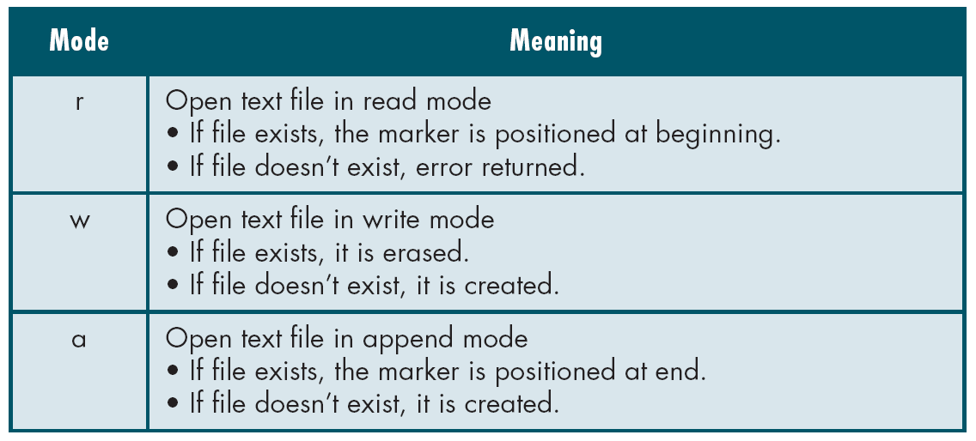
Modes for opening file

Slide 7
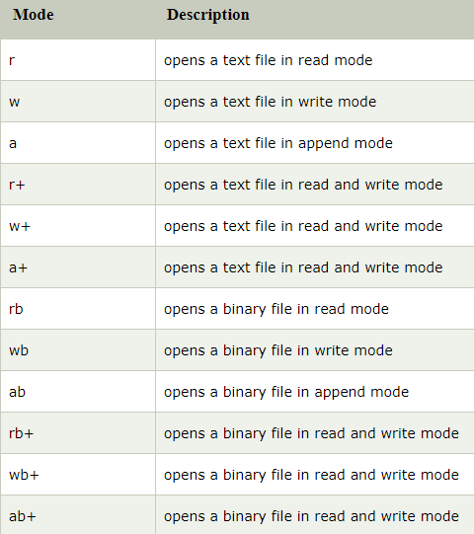
Cont…

Slide 8
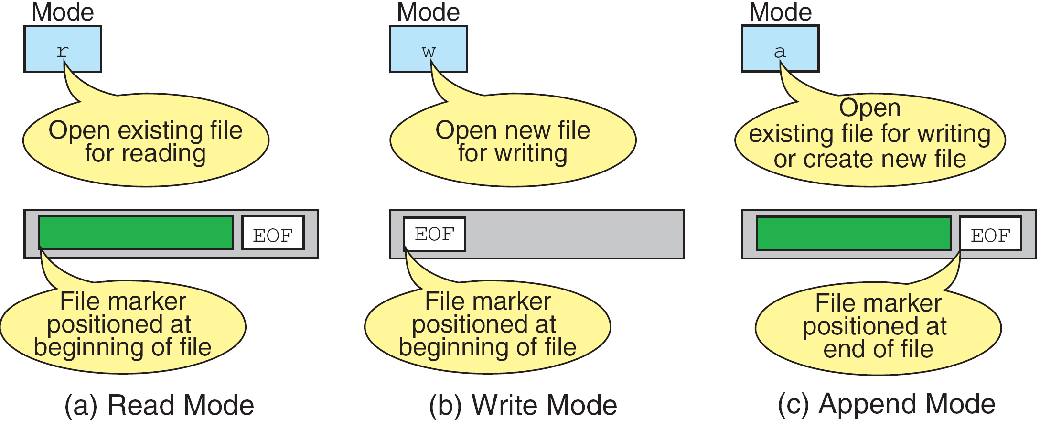
Cont…

Slide 9
Opening File
We must open a file before read, write or update operation.
The file open “fopen()” function serves two purposes:
It makes the connection between the physical file and the stream.
It creates “a program file structure to store the information” C needs to process the file.
Syntax: filepointer=fopen(“filename”, “mode”);
The file mode tells C how the program will use the file.
The filename indicates the system name and location for the file.
Example :
spData = fopen(“MYFILE.TXT”, “w”);
spData = fopen(“A:\\MYFILE.TXT”, “w”);

Slide 10
Cont…

Slide 11
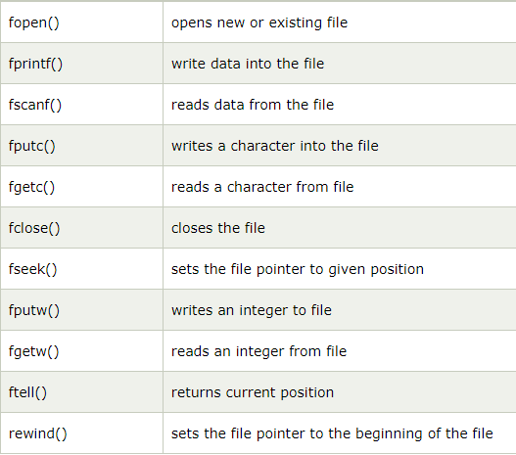
Functions for file handling in c

Slide 12
How fopen() function works
The fopen function works in the following way.
Firstly, It searches the file to be opened.
Then, it loads the file from the disk and place it into the buffer. The buffer is used to provide efficiency for the read operations.
It sets up a character pointer which points to the first character of the file.
Program to read data character by character.
For the above we are assuming that we have file in our system.

Slide 13
How Close file fclose() function works
he fclose() function is used to close a file. The file must be closed after performing all the operations on it. The syntax of fclose() function is given below:
int fclose( FILE *fp );

Slide 14
fprintf() and fscanf() function
fprintf() function is used to write set of characters into file. It sends formatted output to a stream.
int fprintf(FILE *stream, const char *format [, argument, ...])
#include <stdio.h> main() { FILE *fp; fp = fopen("file.txt", "w");//opening file fprintf(fp, "Hello file by fprintf...\n");//writing data into file fclose(fp);//closing file }

Slide 15
Cont…
fscanf() function is used to read set of characters from file. It reads a word from the file and returns EOF at the end of file
int fscanf(FILE *stream, const char *format [, argument, ...])
#include <stdio.h> main() { FILE *fp; char buff[255];//creating char array to store data of file fp = fopen("file.txt", "r"); while(fscanf(fp, "%s", buff)!=EOF){ printf("%s ", buff ); } fclose(fp); } Program to store details of employee

Slide 16
fputc() and fgetc() function
The fputc() function is used to write a single character into file. It outputs a character to a stream.
Syntax : int fputc(int c, FILE *stream)
#include <stdio.h> main() { FILE *fp; fp = fopen("file1.txt", "w");//opening file fputc('a',fp);//writing single character into file fclose(fp);//closing file }

Slide 17
Cont…
The fgetc() function returns a single character from the file. It gets a character from the stream. It returns EOF at the end of file.
int fgetc(FILE *stream)
#include<stdio.h> #include<conio.h> void main() { FILE *fp; char c; clrscr(); fp=fopen("myfile.txt","r"); while((c=fgetc(fp))!=EOF) { printf("%c",c); } fclose(fp); getch(); }

Slide 18
fputs() and fgets() function
fputs() and fgets() in C programming are used to write and read string from stream.
The fputs() function writes a line of characters into file. It outputs string to a stream.
Syntax : int fputs(const char *s, FILE *stream)
#include<stdio.h> #include<conio.h> void main() { FILE *fp; clrscr(); fp=fopen("myfile2.txt","w"); fputs("hello c programming",fp); fclose(fp); getch(); }

Slide 19
Cont…
The fgets() function reads a line of characters from file. It gets string from a stream.
char* fgets(char *s, int n, FILE *stream)
#include<stdio.h> #include<conio.h> void main() { FILE *fp; char text[300]; clrscr(); fp=fopen("myfile2.txt","r"); printf("%s",fgets(text,200,fp)); fclose(fp); getch(); }

Slide 20
fseek() method
The fseek() function is used to set the file pointer to the specified offset. It is used to write data into file at desired location.
int fseek(FILE *stream, long int offset, int whence)
There are 3 constants used in the fseek() function for whence: SEEK_SET, SEEK_CUR and SEEK_END.
SEEK_SET – It moves file pointer position to the beginning of the file.
SEEK_CUR– It moves file pointer position to given location.
SEEK_END – It moves file pointer position to the end of file.

Slide 21
Cont…
#include <stdio.h> void main() { FILE *fp; fp = fopen("myfile.txt","w+"); fputs("This is file in C", fp); fseek( fp, 7, SEEK_SET ); fputs(“Bob the builder", fp); fclose(fp); }

Slide 22
rewind()
The rewind() function sets the file pointer at the beginning of the stream. It is useful if you have to use stream many times.
void rewind(FILE *stream)
#include<stdio.h> #include<conio.h> void main(){ FILE *fp; char c; clrscr(); fp=fopen("file.txt","r"); while((c=fgetc(fp))!=EOF) { printf("%c",c); } rewind(fp);//moves the file pointer at beginning of the file while((c=fgetc(fp))!=EOF) { printf("%c",c); } fclose(fp); getch(); }

Slide 23
Cont…
The ftell() function returns the current file position of the specified stream.
We can use ftell() function to get the total size of a file after moving file pointer at the end of file.
We can use SEEK_END constant to move the file pointer at the end of file.
long int ftell(FILE *stream)

Slide 24
Program of fseek()
#include <stdio.h> #include <conio.h> void main () { FILE *fp; int length; clrscr(); fp = fopen("file.txt", "r"); fseek(fp, 0, SEEK_END); length = ftell(fp); fclose(fp); printf("Size of file: %d bytes", length); getch(); }

Slide 25
Thank You

